Slide 1
Patterns and Anti Patterns
DONT s
1. Control Class Bloat Anti Pattern
2. Anemic Model Anti Pattern
3. GOD Class Anti Pattern
DO s
1. CRC Technique
2. Inheritance versus Composition
3. Composite Pattern

Slide 2
Anti Pattern: Control Class Bloating
Types of Classes : Boundary, Entity, Control
Anti Pattern: Bloating of Control Class
Typical of Procedural Code Migration
Symptom: Separation of Data and Behavior

Slide 3
Anemic Model Anti Pattern
Result of using Controller with lots of logic

Slide 4
Anti Pattern: Behavioral GOD Class
Performs most of work leaving minor details to a collection of trivial classes
Symptoms:
  Classes with names ending with Manager, System Subsystem etc.
  Classes with Names derived from Verbs
  Classes with too many fine grained accessor methods implies some GOD class is asking for this information

Slide 5
Solution: Always use CRC
Class – Responsibility – Collaboration
Identify Core Responsibilities.
Identify what should be delegated and to whom
Draw Draw Draw
Identify CRC Violation
  Too much calls to other objects
  Classes with Names derived from Verbs. Dont make operation into class
  Place agent classes during analysis and remove if not needed

Slide 6
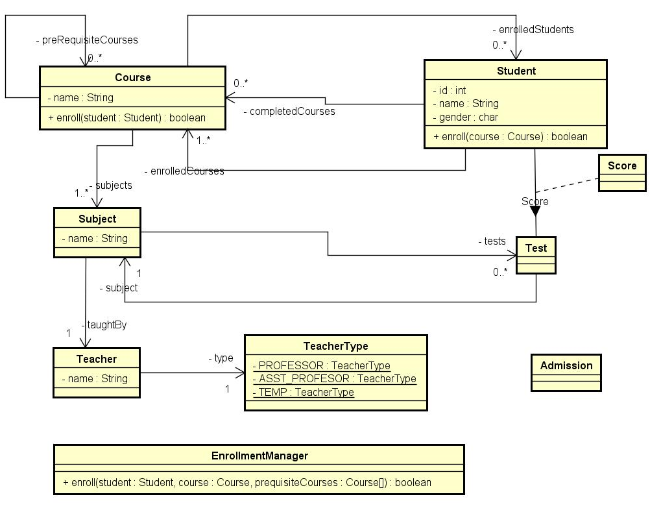
CRC example

Slide 7
CRC Example – How to
Notice the Enroll function in 3 places. Which is right?
Can EnrollmentManager class be eliminated?
Use CRC Technique to identify whose responsibility it is to provide enrollment functionality?
And Which classes should it collaborate to provide that functionality? (Eliminate Agent Classes during Design)
Develop clusters of collaborating classes with DEFINED RESPONSIBILITIES
Merge (Union) the clustered data+ behavior for final UML

Slide 8
NEVER use Inheritance for code reuse
If you want reusable code, use
  Composition
  Helper Classes
Use Inheritance for polymorphic behavior
Roles are candidates for composition
If/Else are symptoms of missing inheritance (already covered)

Slide 9
Composite Design Pattern
Super Class – Sub Class relationship
Containment with multiplicity

Slide 10
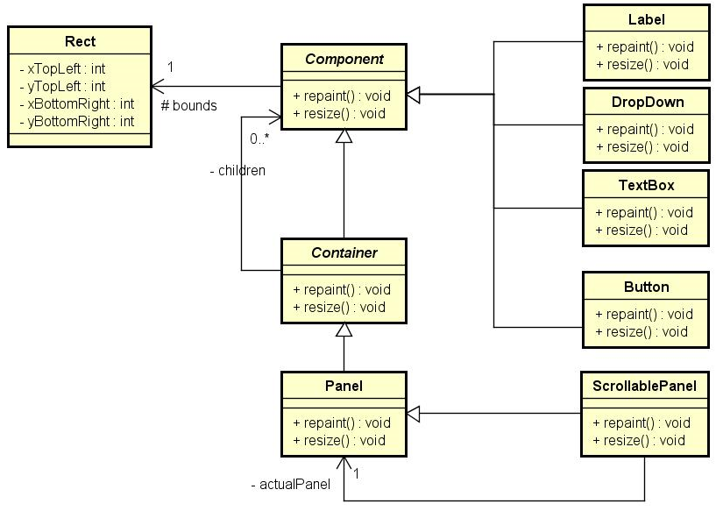
Composite
Pattern
Decorator
Pattern

Slide 11
Next Session
Simple Design Patterns
  Singleton
  Adapter
  Proxy
  Decorator

Slide 12
Next Session
Interfaces
Mock Objects
Object Oriented Programming in Agent/Controller/Service Classes – Dependency Injection
Creational Patterns -
  Builder
  Template Method
  Factory Method
Behavioral Patterns (Visitor,Observer,Command)

